Slide 1
The texaco warehouse
at old placerville

Slide 2
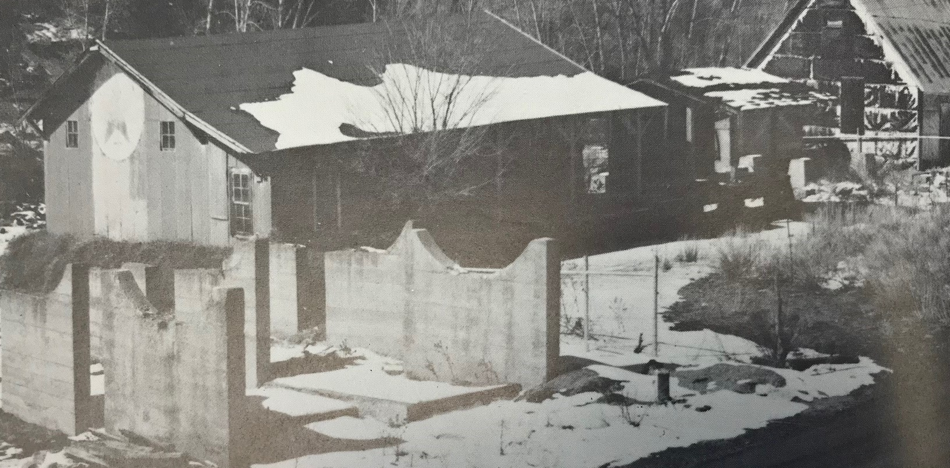
A few shots from the road side.
3 or 4 tanks around the warehouse
Note the white paint from the
Texaco sign running down the end

Slide 3
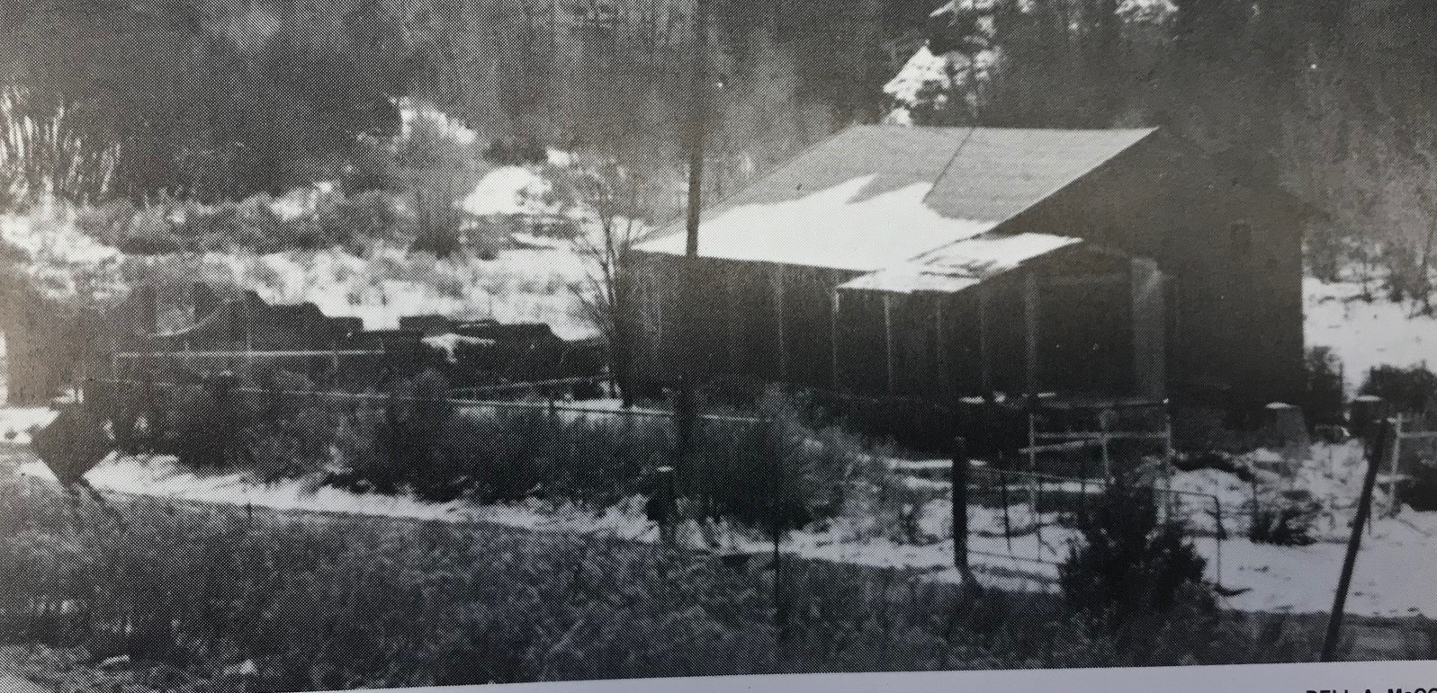
Only the tank saddles left

Slide 4
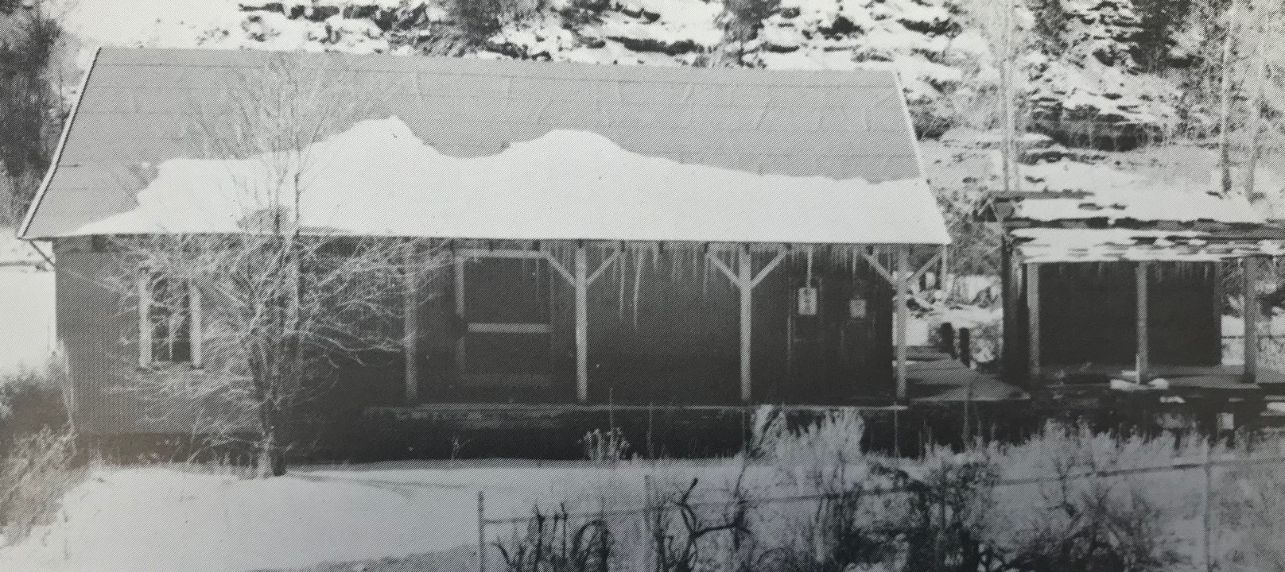
A good shot of the front again. Dang, still on the roadside

Slide 5
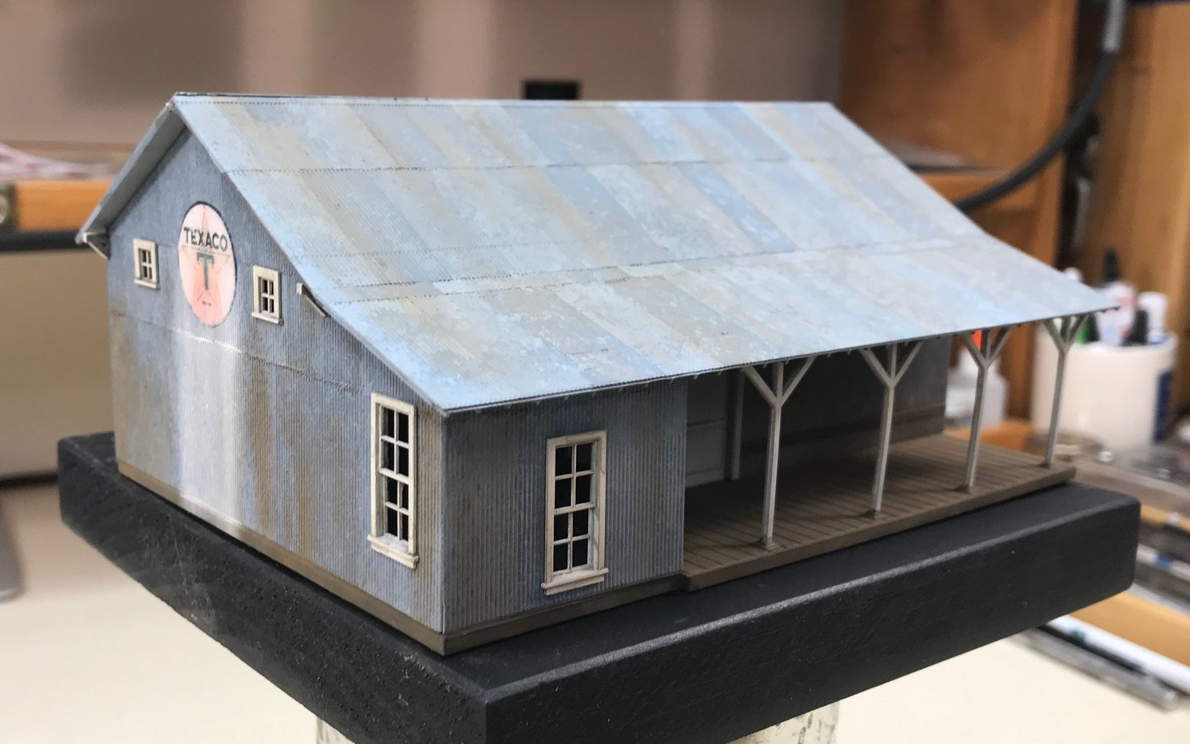
Here’s the model. Sign running on it too

Slide 6
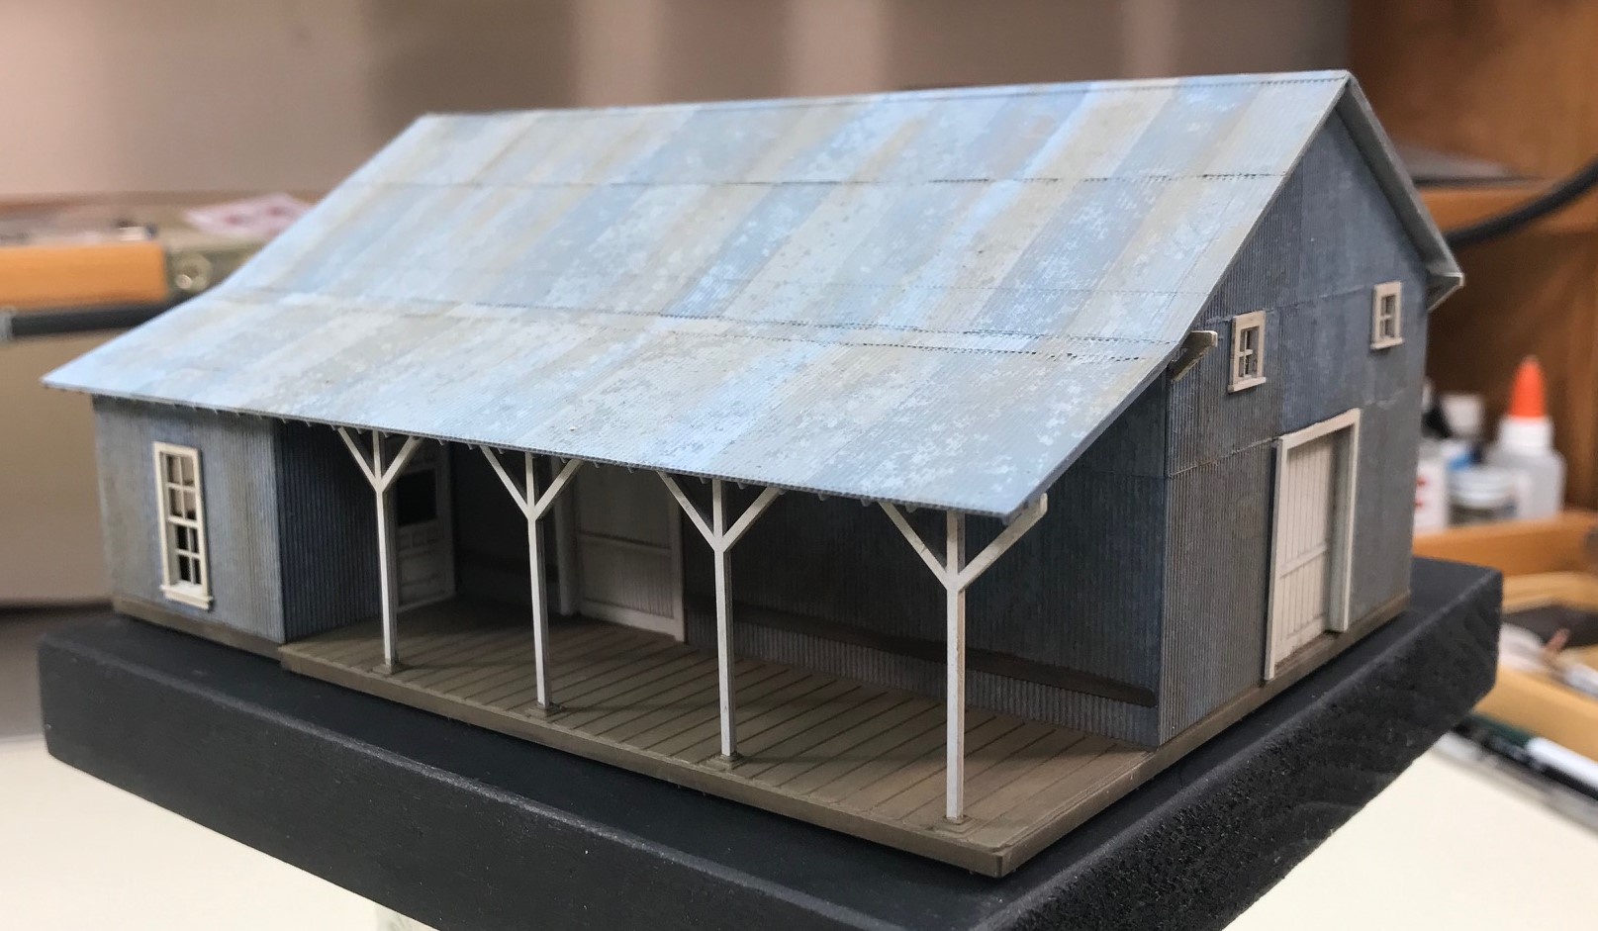
Right front. Grandtline kit.

Slide 7
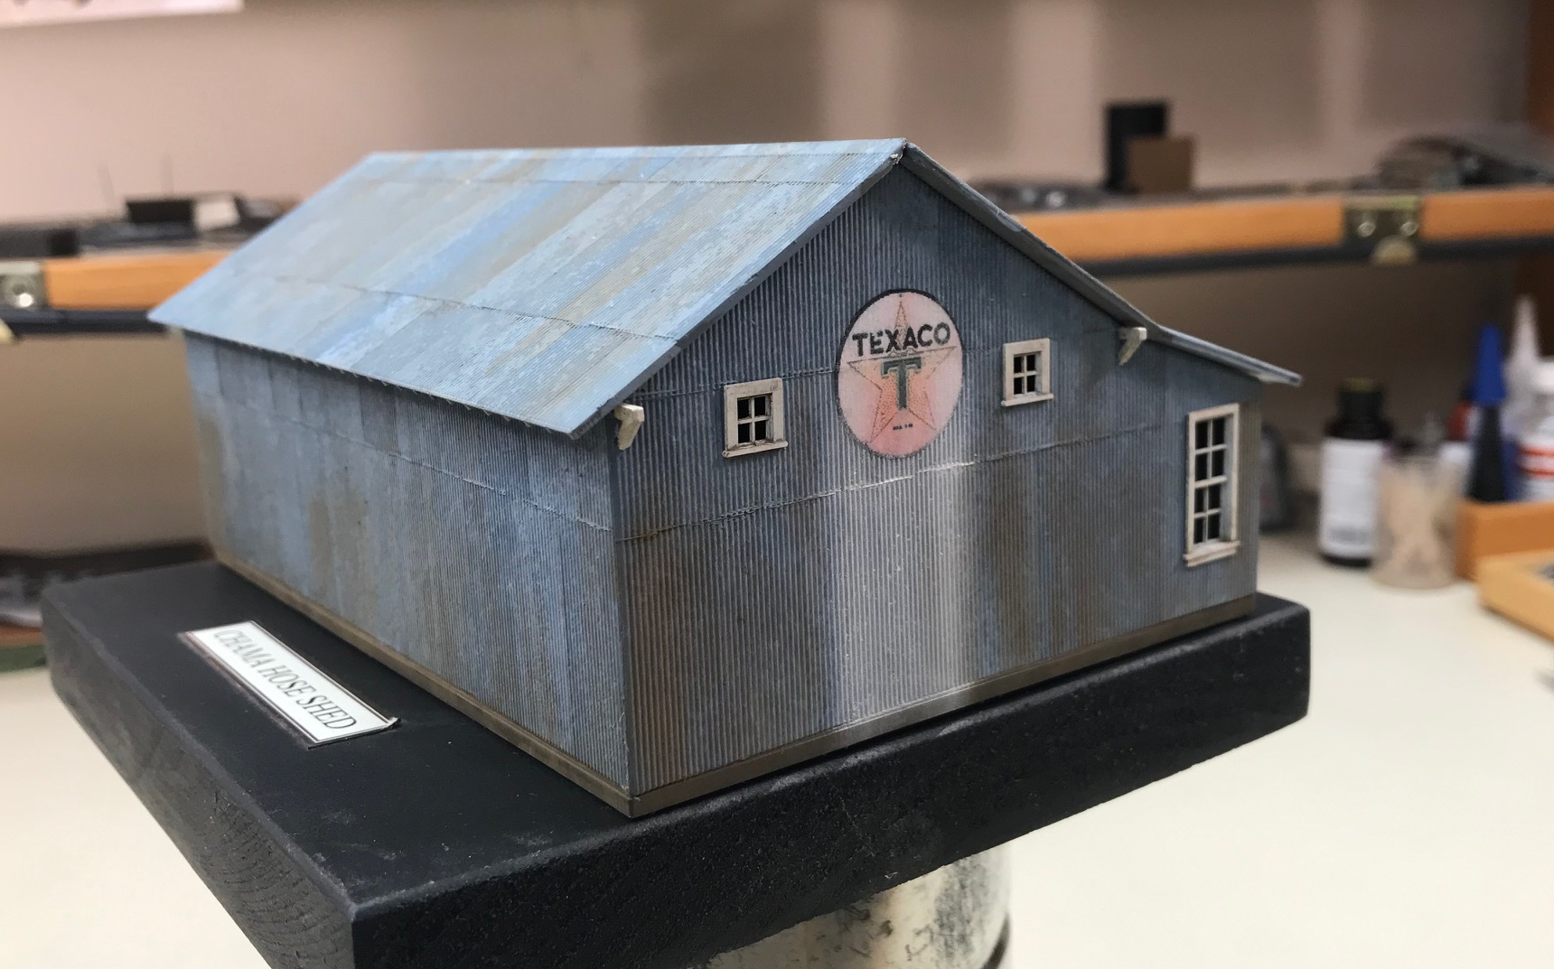
Yup! Sign still running

Slide 8
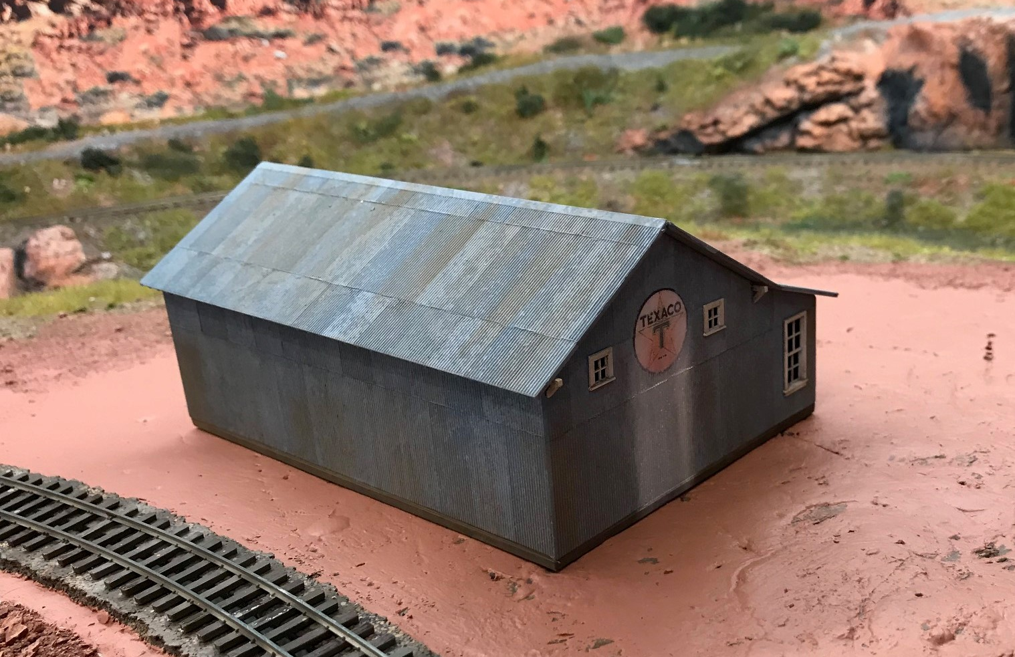
Here it is just sitting in approximate position in old placerville. Just a blank back wall, Oh well!
But, the signs still shows. Tanks to come!

